Slide 1

Lecture 1
August 9, 2023
1

Slide 2
Circuit
What is circuit?
What is Analog and Digital circuits?
2

Slide 3
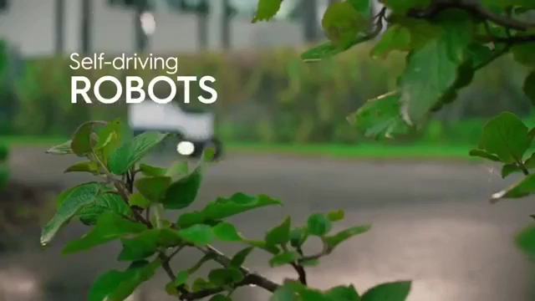
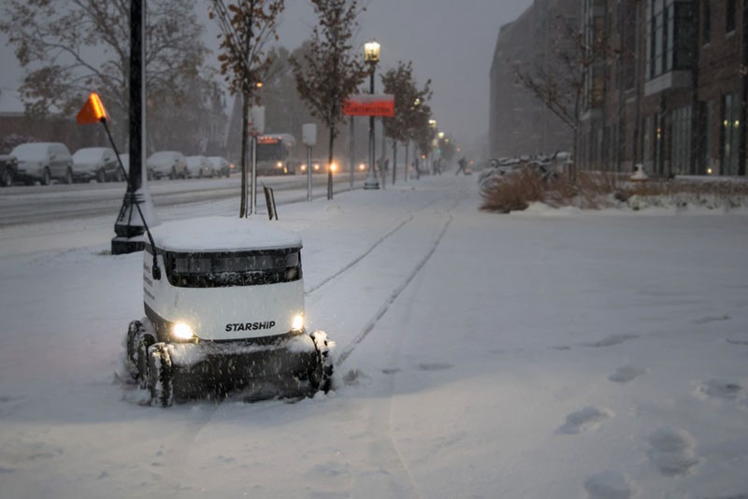
Strength Circuit in Artificial Intelligence
A Day in the Life of a Starship Robot (AI system from Purdue University)
Starship Robot 6E284 is going to deliver the food
Working at (-) 40°C
https://www.purdue.edu/newsroom/stories/2019/a-day-in-the-life-of-a-starship-robot.html
3

Slide 4
What is circuit?
A circuit is a path between two or more points along which an electrical current can be carried.
Discrete circuit
A discrete circuit is an electronic circuit built out of discrete components, such as resistors, transistors, etc., instead of a single integrated circuit.
Integrated circuit
An integrated circuit (IC), sometimes called a chip or microchip, is a semiconductor wafer on which thousands or millions of tiny resistors, capacitors, and transistors are fabricated. An IC can function as an amplifier, oscillator, timer, counter, computer memory, or microprocessor. A particular IC is categorized as either linear (analog) or digital, depending on its intended application.
4

Slide 5
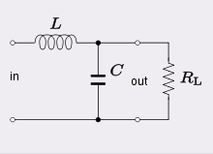
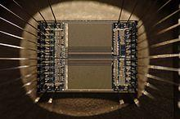
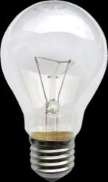

Circuit
Circuit
Discrete circuit
Integrated circuit
5

Slide 6
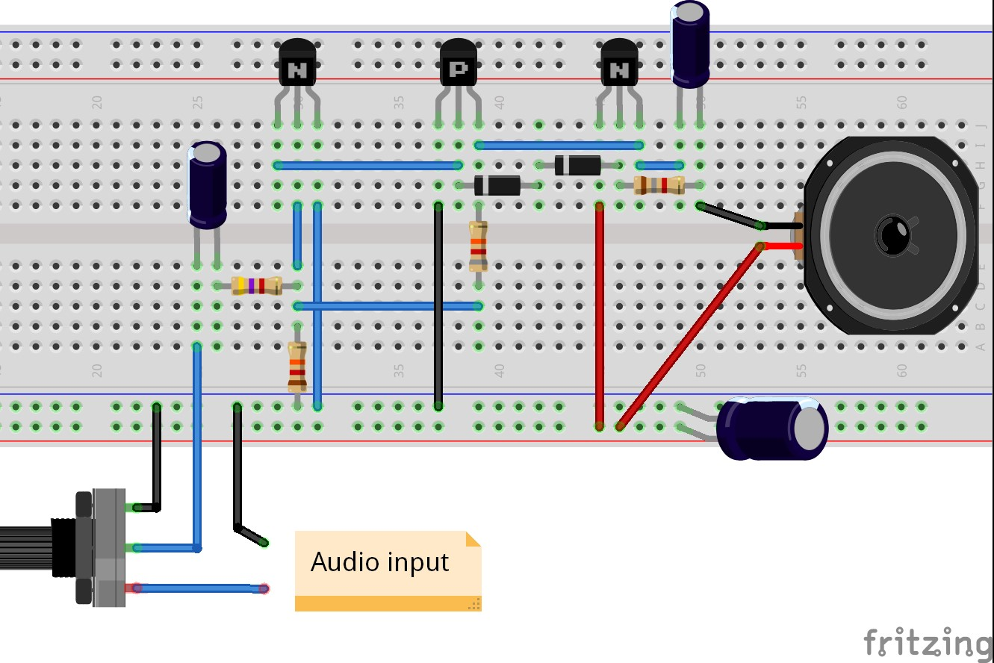
Breadboard Circuit
6

Slide 7
What is electrical and electronic circuit?
Why do we study?
“Electrical circuit” comprises only PASSIVE components, such as resistors, capacitors and inductors.
Passive: No external energy/power source is required
In “electronic circuit" at least one of the components is ACTIVE, or executes some transformation (magnification/reduction) of the current passing through
Active: External energy/power source is required
A filter made of resistors, capacitors and inductors is electric.
The same filter, when using a transistor and/or an op-amp is ACTIVE, and called “electronic”. ➢ Usually, if there is a semi-conductor or some sort of amplifier, we talk of "electronics"
Linear and non-linear components: | Linear: Resistors, capacitors, inductors Nonlinear: diodes
Why do we study?
Any device that is electric power driven has either electric or electronic components. Without electrical and electronic circuit, no progress would have happened as you see today. So it is extremely important for us to learn this subject in order to contribute to modern society.
Even quantum computers: LC circuit
7

Slide 8
Different types of materials
Metals: Resitivity~10⁻⁶ Ω cm
Semiconductors: resitivity~10⁻³ to 10⁹ Ω cm
Insulators: resitivity~10²² Ω cm
Semiconductors have many interesting properties:
(1) Resistivity decreases with increasing temperature (opposite to metals).
Negative temperature coefficient.
(2) They exhibit a phenomenon called photoconductivity
(3) Sign of the carriers can be +ve (n-type and p-type semiconductors)
(4) extreme sensitivity to impurities
(5) Rectifying effects can be obtained when 2 unlike semiconductors are joined.
(6) Can control the number of carriers by electric field
8

Slide 9
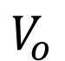
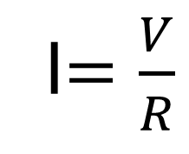
Circuit component : Resistor
Ohms Law
I$=\frac{V}{R}$
Voltage source
V
R
Ideal
I
$$V_{o}$$
V
9

Slide 10
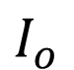
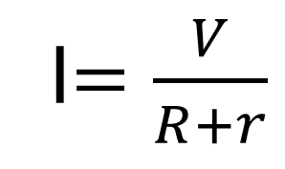
Internal Resistance
Ohms Law
r
I$=\frac{V}{R+r}$
Current source
V
R
$$I_{o}$$
I
Ideal
V
10

Slide 11
Internal Resistance of current source
Normally neglect the internal small resistance
I
r
R
11

Slide 12
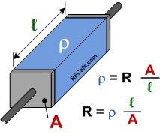
Internal Resistance of current source
Resistance and resistivity ?
12

Slide 13
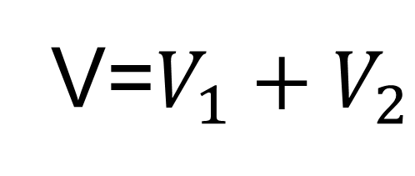
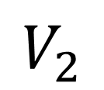
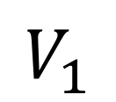
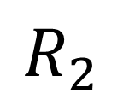
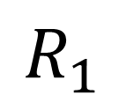
KVL
$$V_{1}$$
In any closed loop network, the total voltage around the loop is equal to the sum of all the voltage drops within the same loop
$$R_{1}$$
$$R_{2}$$
V
$$V_{2}$$
V=$V_{1}+V_{2}$
13

Slide 14
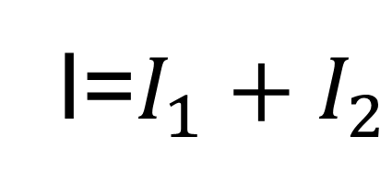
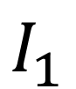
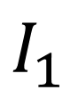
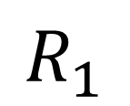
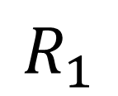
KCL
I
$$I_{1}$$
$$I_{1}$$
The total current entering a junction or a node equals the charge leaving the node as no charge is lost
V
$$R_{1}$$
$$R_{1}$$
I=$I_{1}+I_{2}$
14

Slide 15
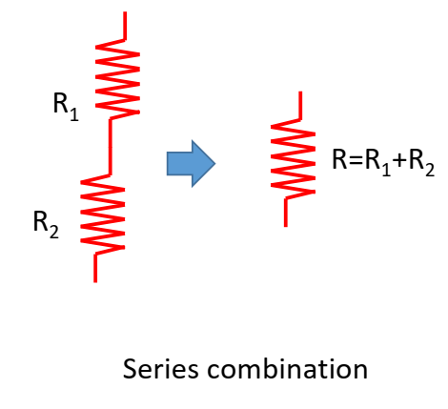
Circuit solution – Series
15

Slide 16
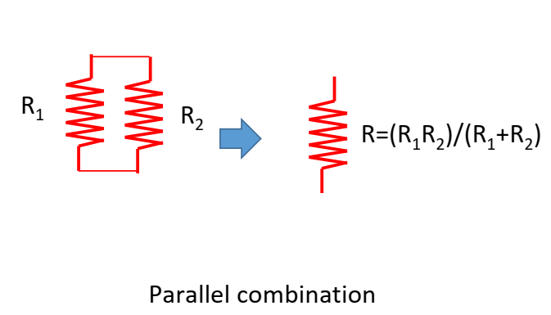
Circuit solution - Parallel
16

Slide 17
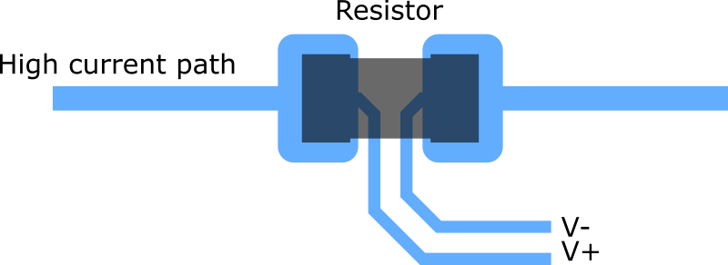
4-probe measurement
17

Slide 18
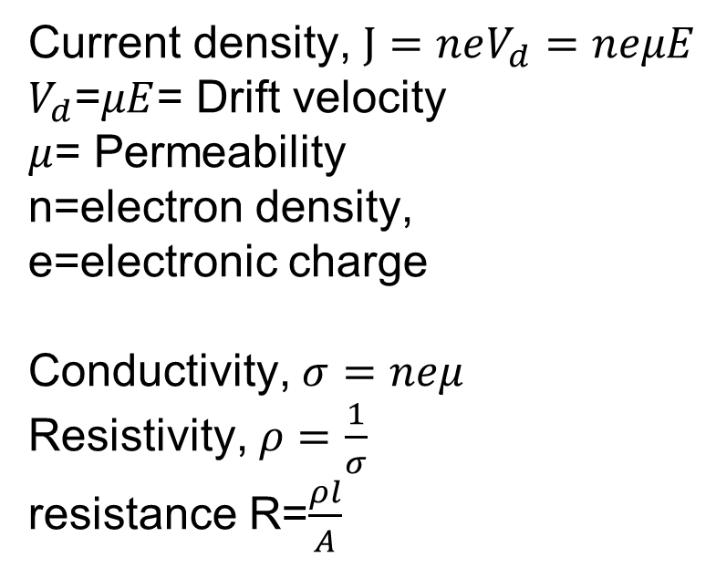
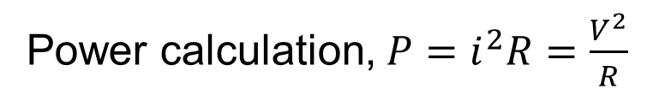
Parameters
Power calculation, $P=i^{2}R=\frac{V^{2}}{R}$
Current density, $J=neV_{d}=neμE$
$V_{d}$=$μE$= Drift velocity
$μ$= Permeability
n=electron density,
e=electronic charge
Conductivity, $σ=neμ$
Resistivity, $ρ=\frac{1}{σ}$
resistance R=$\frac{ρl}{A}$
R
18

Slide 19
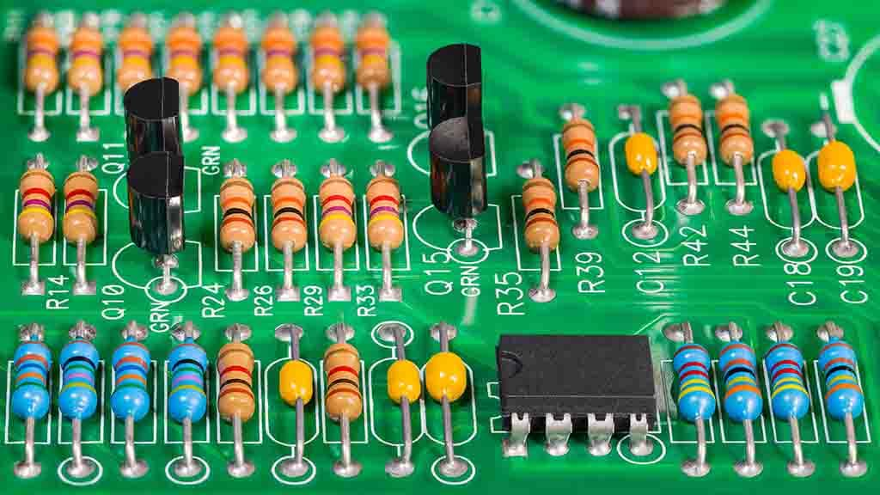
Circuit
19

Slide 20
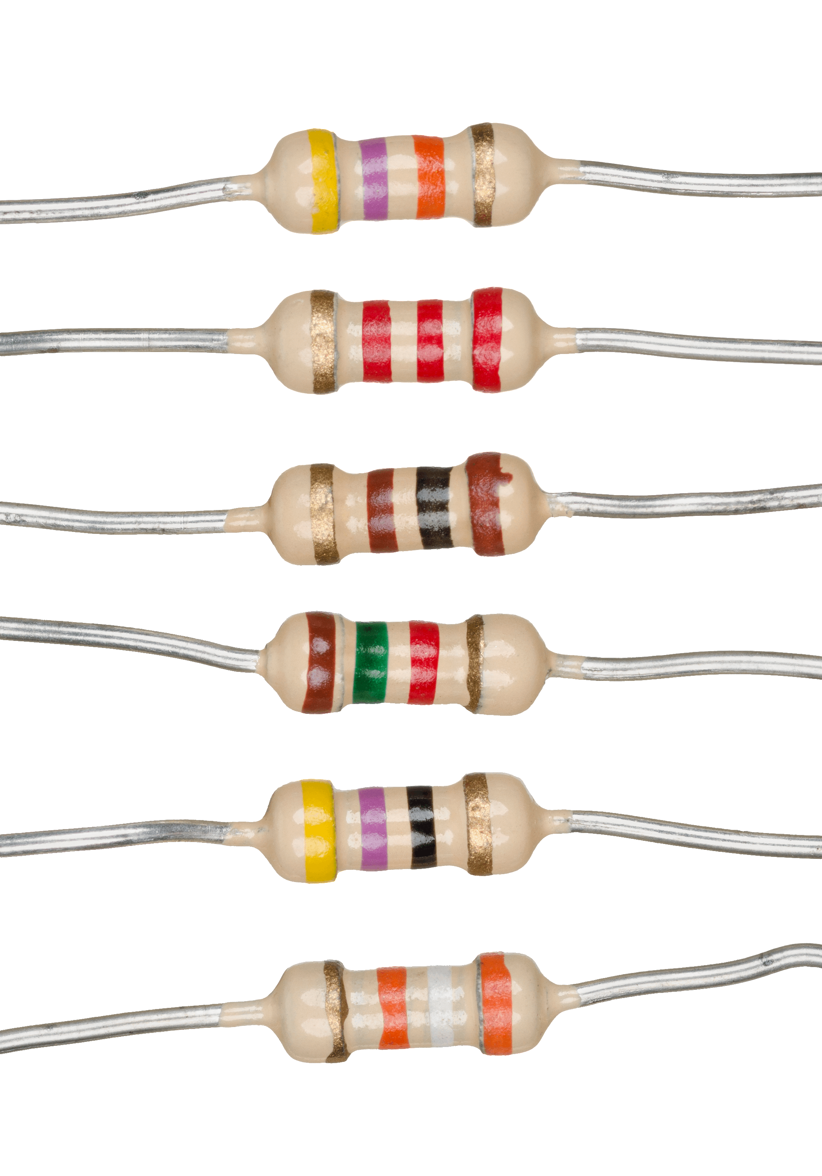
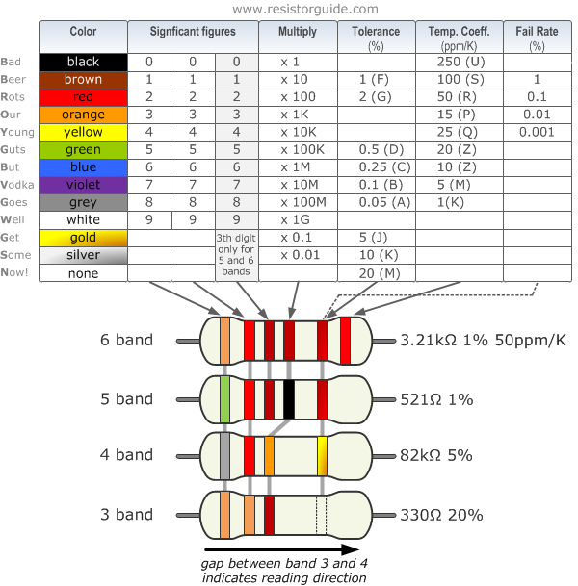
Circuit component : Resistor
20

Slide 21
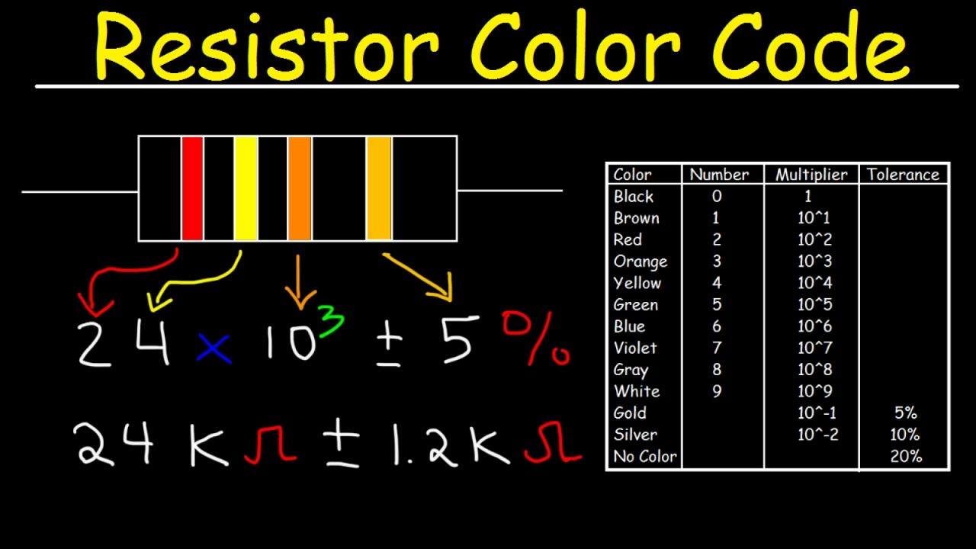
Circuit component : Resistor
21

Slide 22
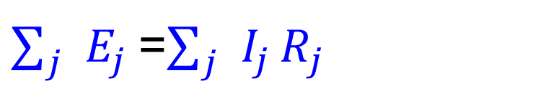
Law of Electricity
Network of conductors:
Where there are junctions between two, three, or more conductors at which the current can flow along various paths and also one or more sources of e.m.f. is acting.
Branch Point:
A branch point is a point of the circuit where three or more conductors are joined.
Loop:
Any network of wires a loop is any closed conducting path.
Kirchhoff's Law:
1st Law: Any network of wires algebraic sum of current meeting in any branch point is zero.
2nd Law: The algebraic sum of the e.m.f in any close circuit or loop at the network is equal to the algebraic sum of the product of the resistance of each line of that circuit or loop and the current flowing through them, provided that for each line ohm’s law is obeyed.
$\sum_{j}{E_{j}}$=$\sum_{j}{I_{j}}R_{j}$
22

Slide 23
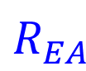
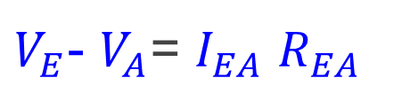
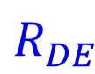
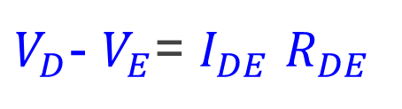
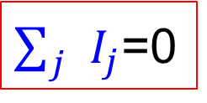
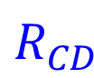
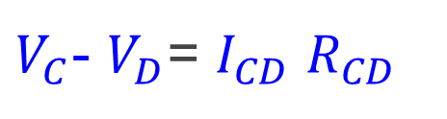
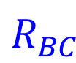
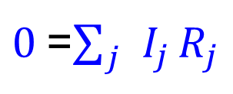
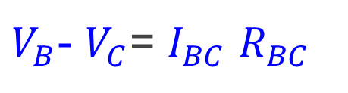
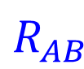
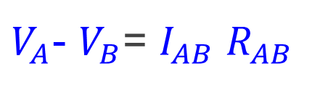
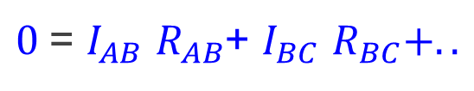
1st Law Information
$$R_{AB}$$
$V_{A}$- $V_{B}$= $I_{AB}$ $R_{AB}$
A
B
$V_{B}$- $V_{C}$= $I_{BC}$ $R_{BC}$
$$R_{EA}$$
$$R_{BC}$$
$V_{C}$- $V_{D}$= $I_{CD}$ $R_{CD}$
E
$V_{D}$- $V_{E}$= $I_{DE}$ $R_{DE}$
$V_{E}$- $V_{A}$= $I_{EA}$ $R_{EA}$
$$R_{DE}$$
C
$$R_{CD}$$
D
$0$= $I_{AB}$ $R_{AB}$+ $I_{BC}$ $R_{BC}+..$
$0$=$\sum_{j}{I_{j}}R_{j}$
$\sum_{j}{I_{j}}$=0
23

Slide 24
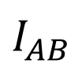
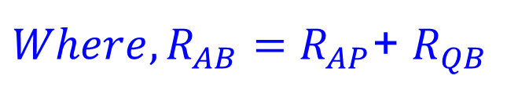
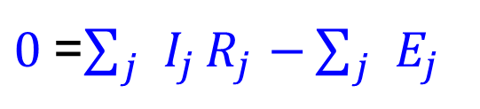
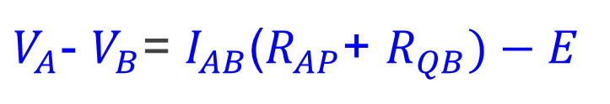
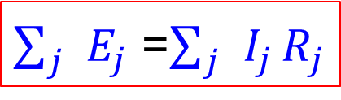
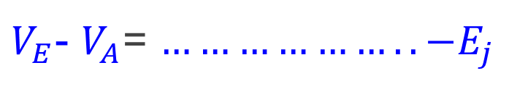







2nd Law Information
$V_{A}$- $V_{P}$= $I_{AP}$ $R_{AP}$
$$I_{AB}$$
$V_{P}$- $V_{Q}$= ${−E}_{}$
$V_{Q}$- $V_{B}$= $I_{QB}$ $R_{QB}$
A
P
Q
B
$$R_{AP}$$
$$R_{QB}$$
$V_{A}$- $V_{B}$= $I_{AB}$($R_{AP}$+ $R_{QB})−E$
$Where, R_{AB}=R_{AP}$+ $R_{QB}$
$$̋̋$$
$$̋̋$$
$$̋̋$$
For the close loop
(Previous slide)
$V_{E}$- $V_{A}$= $………………..{−E}_{j}$
$0$=$\sum_{j}{I_{j}}R_{j}$ $−\sum_{j}{E_{j}}$
$\sum_{j}{E_{j}}$ =$\sum_{j}{I_{j}}R_{j}$
24

Slide 25

















Wheatstone Bridge
A
($I_{2}{−I}_{G}$)
Applying Kirchhoff laws on ABD loop,
${ I}_{2}R_{2}+I_{G}R_{G}{−(I}_{1}−I_{2})R_{4}$= 0
$−I_{1}R_{4}+I_{2}(R_{2}+R_{4})+I_{G}R_{G}$=0
$$R_{1}$$
$$R_{2}$$
$$I_{G}$$
$$I_{2}$$
C
S
G
D
Applying Kirchhoff laws on ABC loop,
$$R_{G}$$
${ (I}_{2}{−I_{G})R}_{1}{−(I}_{1}−I_{2}{+I}_{G})R_{3}−I_{G}R_{G}$= 0
$−I_{1}R_{3}+I_{2}\left(R_{1}+R_{3}\right)−I_{G}(R_{G}+$ $R_{3}+R_{1})$=0
$$K_{2}$$
$$R_{3}$$
$$R_{4}$$
$$I_{1}$$
${(I}_{1}−I_{2}$+ $I_{G}$)
${(I}_{1}−I_{2}$)
Applying Kirchhoff laws on ACEDA loop,
B
${ I}_{2}R_{2}+{(I}_{2}{−I_{G})R}_{1}{+I}_{1}R_{b}−E$= 0
${I_{1}R_{b}+I}_{2}{\left(R_{1}+R_{2}\right)−I_{G}R}_{1}−E$= 0
$$R_{b}$$
$$K_{1}$$
E
25

Slide 26





















Wheatstone Bridge
The three major equation
$−I_{1}R_{4}+I_{2}(R_{2}+R_{4})+I_{G}R_{G}$=0
$−I_{1}R_{3}+I_{2}\left(R_{1}+R_{3}\right)−I_{G}(R_{G}+$ $R_{3}+R_{1})$=0
${I_{1}R_{b}+I}_{2}{\left(R_{1}+R_{2}\right)−I_{G}R}_{1}−E$= 0
Using Cramer’s rule to solve the equation (a determinant form of the equation),
$\frac{I_{1}}{I_{1} Minor}$ = $\frac{I_{2}}{I_{2} Minor}$ = $\frac{I_{G}}{I_{G} Minor}$ = $− \frac{1}{1 Minor}$
$$I_{1}$$
$$I_{2}$$
$$I_{G}$$
$$1$$
$${−R}_{4}$$
$$(R_{2}+R_{4})$$
$$R_{G}$$
$$0$$
$I_{G}$= $− \frac{I_{G} Minor}{1 Minor}$
=
$${−R}_{3}$$
$$(R_{1}+R_{3})$$
$− (R_{G}+$ $R_{3}+R_{1})$
$$0$$
$$R_{b}$$
$$(R_{1}+R_{2})$$
$$−E$$
$${−R}_{1}$$
26

Slide 27




















Wheatstone Bridge
$${−R}_{4}$$
$$(R_{2}+R_{4})$$
$$0$$
$${−R}_{3}$$
$$(R_{1}+R_{3})$$
$$0$$
$I_{G}$= $− \frac{I_{G} Minor}{1 Minor}$= $−$
$$R_{b}$$
$$(R_{1}+R_{2})$$
$$−E$$
$${−R}_{4}$$
$$(R_{2}+R_{4})$$
$$R_{G}$$
$${−R}_{3}$$
$$(R_{1}+R_{3})$$
$− (R_{G}+$ $R_{3}+R_{1})$
$$R_{b}$$
$$(R_{1}+R_{2})$$
$${−R}_{1}$$
= $− \frac{{−R}_{4}[\left(R_{1}+R_{3}\right)E+\left(R_{2}+R_{4}\right){(R}_{3}E\text{)} }{1 Minor}$
27

Slide 28





Wheatstone Bridge
$I_{G}$= $− \frac{I_{G} Minor}{1 Minor}$=$− \frac{{−R}_{4}[\left(R_{1}+R_{3}\right)E+\left(R_{2}+R_{4}\right){(R}_{3}E\text{)} }{1 Minor}$
$=− \frac{E[\left(R_{4}R_{1}−R_{3}R_{2}\right) }{1 Minor}$
Condition for balance indicates $I_{G}$= 0
$$0=E[\left(R_{4}R_{1}−R_{3}R_{2}\right)$$
$$R_{4}R_{1}=R_{3}R_{2}$$
$\frac{R_{1}}{R_{2}}=$ $\frac{R_{3}}{R_{4}}$
28

Slide 29












Wheatstone Bridge
Find out 1 minor?
$${−R}_{4}$$
$$(R_{2}+R_{4})$$
$$R_{G}$$
$$1 Minor=$$
$${−R}_{3}$$
$$(R_{1}+R_{3})$$
$− (R_{G}+$ $R_{3}+R_{1})$
$$R_{b}$$
$$(R_{1}+R_{2})$$
$${−R}_{1}$$
$$1 Minor=$$
$R_{G}R_{b}(R_{1}+$ $R_{2}+R_{3}+R_{4})+R_{G} \left(R_{1}+ R_{2}\right)\left(R_{3}+R_{4}\right)+R_{b}\left(R_{1}+ R_{3}\right)\left(R_{2}+R_{4}\right)+R_{1}R_{2}(R_{3}+ R_{4})+{R_{3}R_{4}(R}_{1}+R_{2})$
29

Slide 30












Wheatstone Bridge Sensitivity
A
$$I_{1}$$
r = unknown resistance
$$nmR$$
$$mR$$
$${I+I}_{G}$$
Applying Kirchhoff laws on ABC loop,
$$I_{G}$$
$I_{1}nmR−\left(I{+I}_{G}\right)nR−I_{G}R_{G}$= 0
$I_{1}nmR−InR−I_{G}{(R}_{G}+nR)$= 0……(1)
B
G
D
$$R_{G}$$
Applying Kirchhoff laws on ADC loop,
$$R_{3}$$
$$r$$
$I_{G}R_{G}+{(I}_{1}+I_{G})mR−Ir$ = 0
$I_{1}mR−Ir+$ $I_{G}$($R_{G}+mR)=0$
${(I}_{}+I_{1}+I_{G}$)
$${I+I}_{G}$$
$$I$$
C
Multiplying “n” we get,
$I_{1}nmR−Inr+$ $I_{G}n$($R_{G}+mR)=0..(2)$
E
30

Slide 31

















Wheatstone Bridge Sensitivity
$I_{1}nmR−Inr+$ $I_{G}n$($R_{G}+mR)=0…(2)$
A
$$I_{1}$$
$I_{1}nmR−InR−I_{G}{(R}_{G}+nR) =$ 0……(1)
$$−$$
$$+$$
$$+$$
$$nmR$$
$$mR$$
$${I+I}_{G}$$
$$I_{G}$$
$In\left(R−r\right)−I_{G}{n(R}_{G}+mR+R+\frac{R_{G}}{n}) =$ 0
B
G
D
$nI_{G}\{R_{G}\left(1+\frac{1}{n}\right)+R\left(1+m\right)\} =$ $In\left(r−R\right)$
$$R_{G}$$
$$R$$
$$r$$
$$\frac{I_{G}}{I}=\frac{\left(r−R\right)}{R_{G}\left(1+\frac{1}{n}\right)+R(1+m)}$$
${(I}_{}+I_{1}+I_{G}$)
$${I+I}_{G}$$
$$I$$
C
E
31

Slide 32




Wheatstone Bridge Sensitivity
$$\frac{I_{G}}{I}=\frac{\left(r−R\right)}{R_{G}\left(1+\frac{1}{n}\right)+R(1+m)}$$
A
$$I_{1}$$
$$nmR$$
$$mR$$
$${I+I}_{G}$$
$I_{G}$ can be increased by,
Increasing $I$ (Heating effect)
Decreasing $I_{G}$ (Not scientific)
Increasing $n$ ($n→∝$)
Decreasing $m$($m→0$)
$$I_{G}$$
B
G
D
$$R_{G}$$
$$R$$
$$r$$
${(I}_{}+I_{1}+I_{G}$)
Hence, $\frac{I_{G}}{I}=\frac{\left(r−R\right)}{R_{G}+R}$
$${I+I}_{G}$$
$$I$$
C
When $m=n=1, \frac{I_{G}}{I}=\frac{\left(r−R\right)}{{2(R}_{G}+R)}$
E
32

Slide 33
Concept Questions-1
A cube is formed by joining equal wires each of the resistance R, and a battery is connected to two opposite corners of a face of the cube. Show that the effective resistance between these points is 3R/4 4
A cube is formed by joining equal wires each of the resistance R. Calculate the equivalent resistance between two corners on the same edge of the cube. 3
A cube is formed by joining equal wires each of the resistance R. Calculate the equivalent resistance between the diagonally opposite two corners of the cube.
33

Slide 34



Capacitors
Capacitance
C$=\frac{εA}{d}$
Energy stored in capacitor
=$\int{vidt=\int{C}\frac{dv}{dt}dt=\frac{1}{2}cv^{2}=\frac{Q^{2}}{2C}}$
34

Slide 35






Capacitors
Series Cap
$\frac{1}{C} =\frac{1}{C_{1}}$+ $\frac{1}{C_{2}}$
Parallel Cap
C= $C_{1}+C_{2}$
$$C_{1}$$
$$C_{1}$$
$$C_{2}$$
$$C_{2}$$
35

Slide 36


















LR circuit : Growth of Current
$$∈ =−L\frac{di}{dt}$$
$i$= instantaneous current
Back e.m.f
$$E=Ri+L\frac{di}{dt}$$
$$L$$
$$R$$
e.m.f equation,
$$E$$
$$K$$
$$\frac{di}{E−Ri}=\frac{dt}{E}$$
$−\frac{1}{R}\ln\left(E−Ri\right)=\frac{t}{L}+K$
Upon integrating,
$Boundary condition: t=0, i=0, so K=−\frac{1}{R}\ln\left(E\right)$
$K$= Integrating constant
$\ln{\frac{\left(E−Ri\right)}{E}}=−\frac{Rt}{L}$
$1−{\frac{Ri}{E}}=e^{−\frac{Rt}{L}}$
$i=\frac{E}{R}{(1−e}^{−\frac{Rt}{L}}$)
$i=i_{o}{(1−e}^{−\frac{Rt}{L}}$)
$$Where, i_{o}=\frac{E}{R}$$
$Boundary condition: t=∝, i=i_{o}, If we put t=\frac{L}{R}=time constant of circuit$
$i=i_{o}{(1−e}^{−1}$)
$i=i_{o}(1−\frac{1}{2.72}$)
$$i={0.63 i}_{o}$$
$$The time taken for the current to reach 0.63 or 63 percent of its final value is the time constant of the circuit$$
36

Slide 37
















LR circuit : Growth of Current
$$i={0.63 i}_{o}$$
$$L$$
$$R$$
$$E/R$$
$$0.63E/R$$
$$98\%$$
$$E$$
$$K$$
$$Growth$$
$\frac{E}{R}{(1−e}^{−\frac{Rt}{L}}$)
Voltage drop across R
$${ v}_{R}\left(t\right)=Ri\left(t\right)={E(1−e}^{−\frac{Rt}{L}})$$
$$t=\frac{L}{R}→Greater L and smaller R$$
$$indicates larger time constant$$
$$i$$
$$E$$
$${ v}_{R}$$
$${{ v}_{R}v}_{L}$$
$$t(=L/R)$$
It is easy to see that the current rises to nearly 98% of its final value in four-time constants. The transient is thus said to practically die out four times constants
$${ v}_{L}$$
$$t$$
Voltage drop across L:${ v}_{L}\left(t\right)=E−{ v}_{R}\left(t\right)={Ee}^{−\frac{Rt}{L}}$
37

Slide 38













LR circuit : Decay of Current
$$∈ =−L\frac{di}{dt}$$
$i$= instantaneous current
Back e.m.f
$$Ri+L\frac{di}{dt}=0$$
$$L$$
$$R$$
e.m.f equation,
$$E$$
$$K$$
$$\frac{di}{i}=−\frac{R}{L}dt$$
Upon integrating,
$\ln\left(i\right)=−\frac{R}{L}t+K$
$K$= Integrating constant
$Boundary condition: t=0, i=i_{o}, so, K=\ln\left(i_{o}\right)$
$\ln{\frac{i}{i_{o}}}=−\frac{Rt}{L}$
$i={i_{o}e}^{−\frac{Rt}{L}}$
$$i=−\frac{E}{R}e^{−\frac{Rt}{L}}$$
$$Where, i_{o}=\frac{E}{R}$$
$$If we put t=\frac{L}{R}=time constant of circuit$$
$i=i_{o}{(e}^{−1}$)
$i=i_{o}(\frac{1}{2.72}$)
$$i={0.37 i}_{o}$$
$$The time constant\frac{L}{R} is the time taken by the current to decay to 0.37 or 37\% of its initial value$$
38

Slide 39














LR circuit : Decay of Current
$$i={0.37 i}_{o}$$
$$i$$
$$L$$
$$R$$
$$t=\frac{L}{R}→Time taken by the currentb to decay to$$
$$0.37 or 37\% of its initial value$$
$${ i}_{o}$$
$$E$$
$$K$$
Voltage drop across resistor
$$E$$
$${ v}_{R}\left(t\right)=Ri\left(t\right)={Ee}^{−\frac{Rt}{L}}$$
$${0.37 i}_{o}$$
$${{ v}_{R}v}_{L}$$
$${ v}_{R}$$
$$t(=L/R)$$
$$0$$
$$t$$
$${ v}_{L}$$
The current decreases to nearly 2% of its initial value in four-time constants. The transient is thus said to practically die out four times constants
$$−E$$
Voltage drop across L
$${ v}_{L}\left(t\right)=−{ v}_{R}\left(t\right)={−Ee}^{−\frac{Rt}{L}}$$
39

Slide 40
















RC circuit : Growth of Current
$$E=Ri+\frac{q}{c}$$
$i$= $\frac{dq}{dt}=$ instantaneous current
e.m.f equation,
$$E=R\frac{dq}{dt}+\frac{q}{c}$$
$$R$$
$$C$$
$$\frac{dq}{E−q/c}=\frac{dt}{E}$$
$$E$$
$$K$$
Upon integrating,
$−c\ln\left(E−\frac{q}{c}\right)=\frac{t}{R}+K$
$Boundary condition: t=0, q=0, so, K=−c\ln\left(E\right)$
$K$= Integrating constant
$−c\ln\left(E−\frac{q}{c}\right)=\frac{t}{R}−c\ln\left(E\right)$
$\ln\left(\frac{E−\frac{q}{c}}{E}\right)=\frac{t}{CR}$
$q=q_{o}{(1−e}^{−\frac{t}{CR}}$)
$$Where, q_{o}=Ec$$
$Boundary condition: t=∝, q=q_{o}, If we put t=cR=time constant of circuit$
$q=q_{o}{(1−e}^{−1}$)
$q=q_{o}(1−\frac{1}{2.72}$)
$$q={0.63 q}_{o}$$
$$The time taken for a capacitor to aquire 0.63 or 63\% of its final maximum charge$$
40

Slide 41














RC circuit : Growth of Current
$$q={0.63 q}_{o}$$
$$R$$
$$C$$
$$q$$
$$E$$
$$K$$
$$q_{o}=CE$$
$$98\%$$
Voltage drop across R
$$Growth$$
$q=q_{o}{(1−e}^{−\frac{t}{CR}}$)
$$0.63q_{o}$$
$$τ=CR→time constant$$
Voltage drop across R:
${ v}_{R}\left(t\right)=Ri=\frac{q_{o}}{C}e^{−\frac{t}{CR}}=$ $Ee^{−\frac{t}{CR}}$
$$t$$
$$o$$
$$τ$$
Voltage drop across C:
$${ v}_{c}\left(t\right)=E−{ v}_{R}\left(t\right)=E(1−e^{−\frac{t}{CR}})$$
Charging current:$i=\frac{dq}{dt}$ = $\frac{q_{o}}{CR}e^{−\frac{t}{CR}}$
41

Slide 42










RC circuit : Decay of Current
e.m.f equation,
$$E=Ri+\frac{q}{c}$$
$i$= $\frac{dq}{dt}$
$$\frac{q}{c}+R\frac{dq}{dt}=E=0$$
$$R$$
$$C$$
As E= 0
$$\frac{dq}{q}=\frac{dt}{CR}$$
$$E$$
$$K$$
Upon integrating,
$\ln{q}=−\frac{t}{CR}+K$
$K$= Integrating constant
$Boundary condition: t=0, q=q_{o}, so, K=\ln\left(q_{o}\right)$
$K$= Integrating constant
$$\ln{q}=−\frac{t}{CR}+\ln\left(q_{o}\right)$$
$\ln\left(\frac{q}{q_{o}}\right)=−\frac{t}{CR}$
$$q=q_{o}e^{−\frac{t}{CR}}$$
$$If we put t=τ=CR=time constant of circuit$$
$q=q_{o}{(e}^{−1}$)
$q=q_{o}(\frac{1}{2.72}$)
$$q={0.37 q}_{o}$$
$$The time constant "CR" is the time taken by the charge to decay to 0.37 or 37\% of its initial value$$
42

Slide 43










LR circuit : Decay of Current
$$q$$
$$q={0.37 q}_{o}$$
$$R$$
$$C$$
$${ q}_{o}$$
$$τ=CR→Time taken by the charge to decay to$$
$$0.37 or 37\% of its initial value$$
$$E$$
$$K$$
$${0.37 q}_{o}$$
Voltage drop across R:
${ v}_{R}\left(t\right)=Ri=−\frac{q_{o}}{C}e^{−\frac{t}{CR}}=$ $−Ee^{−\frac{t}{CR}}$
$$t$$
$$τ(=CR)$$
A capacitor would fully discharge in one time constant if its charge decayed at the initial time rate
Voltage drop across C:
${ v}_{c}\left(t\right)=\frac{q}{C}=\frac{q_{o}}{C}e^{−\frac{t}{CR}}=Ee^{−\frac{t}{CR}}$
Charging current:$i=\frac{dq}{dt}$ = $−\frac{q_{o}}{CR}e^{−\frac{t}{CR}}$
43

Slide 44
LR circuit : AC
$$∈ =−L\frac{di}{dt}$$
$i$= instantaneous current
Back e.m.f
$$v(t)e^{jωt}=Ri+L\frac{di}{dt}$$
$$L$$
$$R$$
e.m.f equation,
$$v(t)$$
$$K$$
$Impedance:Z=R+jωL=|Z|e^{jθ}$ where, $tan θ=\frac{ωL}{R}$
$$|Z|=\sqrt{R^{2}−ω^{2}L^{2}}$$
$Current:i=\frac{v_{o}}{Z}$ $e^{jωt}=\frac{v_{o}}{|Z|} e^{j(ωt−θ)}$
$Real Part of:i_{r}=\frac{v_{o}}{\left|Z\right|}\text{cos}(ωt−θ)$
$$v=ZI$$
$$V_{L}=jωLI$$
$Imaginary Part of:i_{i}=\frac{v_{o}}{\left|Z\right|}\text{sin}(ωt−θ)$
$$θ$$
$$I$$
$$V_{R}=RI$$
$Ohm^{′}s law$
$$\frac{v}{Z}=I,$$
$v=(R+jωL)$I=$V_{R}+V_{L}$
$$Phasor Diagram$$
44

Slide 45
CR circuit : AC
e.m.f equation,
$$v(t)e^{jωt}=Ri+\frac{q}{c}$$
$$C$$
$$R$$
$$jωv_{o}e^{jωt}=R\frac{di}{dt}+\frac{1}{C}i$$
$$v(t)$$
$$K$$
$Stedy state solution:i=Ae^{jωt}$
Where, $A=$ $\frac{v_{o}}{R−j/(ωC)}=\frac{v_{o}}{Z}$
$i$= $\frac{dq}{dt}=$ instantaneous current
$Impedance:Z=R−j/(ωC)=|Z|e^{−jθ}$ where, $tan θ=1/(ωCR)$
$Current:i=\frac{v_{o}}{Z}$ $e^{jωt}=\frac{v_{o}}{|Z|} e^{j(ωt+θ)}$
$$V_{R}=RI$$
$$I$$
$Real Part of:i_{r}=\frac{v_{o}}{\left|Z\right|}\text{cos}(ωt+θ)$
$$θ$$
$$V_{C}=−j/(ωC)$$
$Imaginary Part of:i_{i}=\frac{v_{o}}{\left|Z\right|}\text{sin}(ωt+θ)$
$$v=ZI$$
$Ohm^{′}s law$
$$\frac{v}{Z}=I,$$
$v=[R−j/(ωC)]$I=$V_{R}+V_{C}$
$$Phasor Diagram$$
45

